Slide 1


University of Connecticut – Business Analytics & Project Management | Capstone Project
Team 3:
Aishwary Bodhale
Rafia Haseeb
Prakhar Jain
Gowtham Janga
Priyanka Patel
Ritesh Singla
Notes:
Good evening everyone. We are team three and we will be presenting today our capstone project for our sponsor Cigna.
Our team members include …

Slide 2


Agenda
Problem Statement
The Data Set
Exploratory Data Analysis
Visualization
Methodology - Objective 1
Preprocessing
Modeling
Results
Methodology - Objective 2
Preprocessing
Modeling
Results
Recommendations
Notes:
Before moving on further, we would like to share the agenda for today. With a brief overview of the business problem and the dataset, we’ll start with some data analysis and share some of the important insights that we found. After that we will present our solutions for the two problem statements and conclude with some of the recommendations.

Slide 3

Problem Statement
With almost 450 incidents every hour and 1781 technical teams supporting the incident resolution, Cigna aims to improve routing accuracy as well as improve real time prioritization, thereby saving time. Two main objectives are:
Objective 1: Predict the top 3 technology teams to be engaged in order to improve routing accuracy and time to engage.
Objective 2: Predict the probability of an incident becoming a managed incident in order to improve real time prioritization.
Notes:
In order to improve the routing accuracy and real time prioritization, the two main objectives as shared by Cigna were: first, to predict the top 3 technology teams for a particular incident and second, to predict the probability of an incident becoming a managed incident.

Slide 4
Data set
Data Overview :
41 variables describing incident details
328,240 incidents
INC – Incident , MINC – Managed Incident
Variable Overview :
PRIORITY : High Impact Outages Priorities M1, M2, M3
ASSIGNMENT_GROUP : Provides the unique name for the group the INC is assigned to. 407 unique categories
DESCRIPTION : Complete description of what is occurring
IMPACT : Describes the level of impact the INC is having - 1,2,3,4
Notes:
The dataset provided by the company had 41 different variables and contained the information of about 328240 incidents. Some of the incident describing columns in the dataset included priority of an incident, assignment group to which it was allocated, description of the incidents, how much is the impact of that particular incident, when did the incident open and got resolved and so on.

Slide 5
Exploratory Data Analysis (EDA)

Slide 6
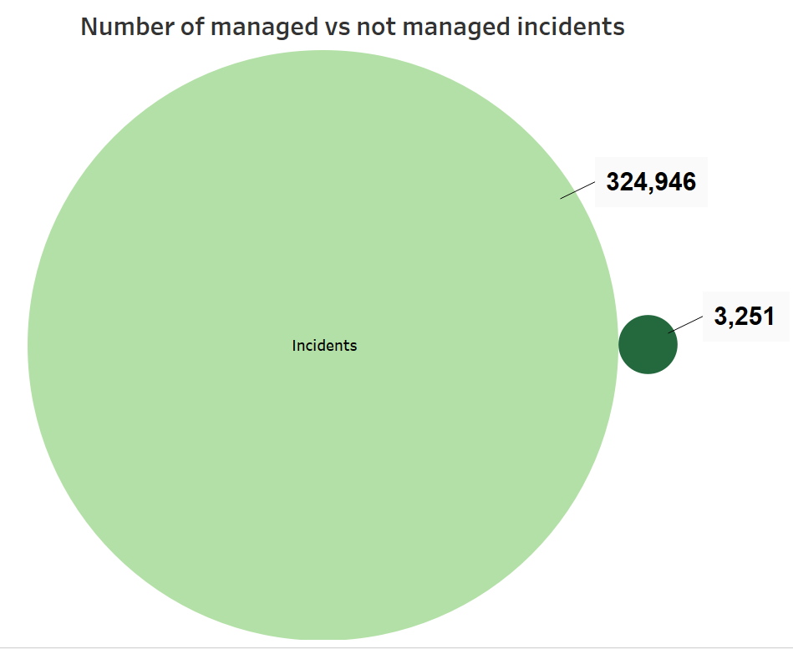
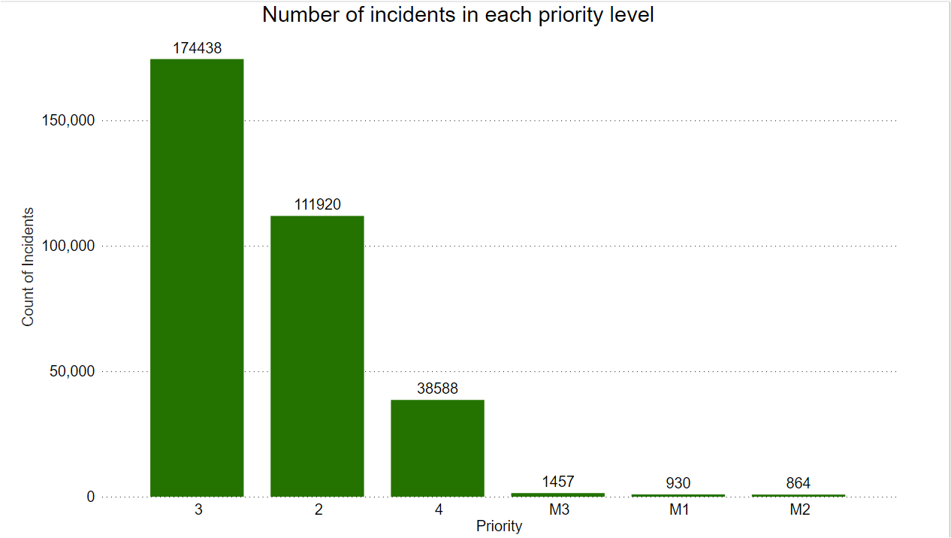
Exploratory Data Analysis
Notes:
To dig deeper into the data that was provided to us, we performed EDA.
Few of the insights that we could capture was,
The data was imbalance. Number of non managed incidents were almost 99% of the data while managed incidents were only 1%
Number of incidents in each priority level was identified. As we can see in the bar graph, Most number of incidents were Moderate and high priority

Slide 7
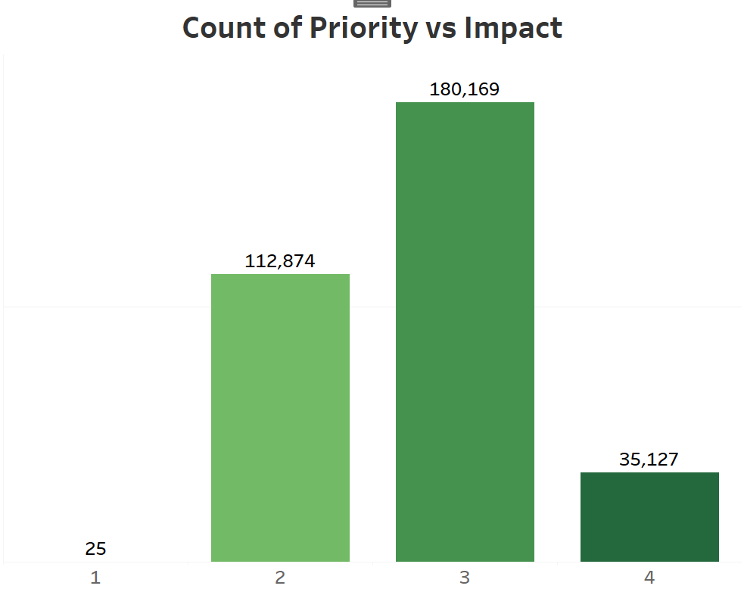
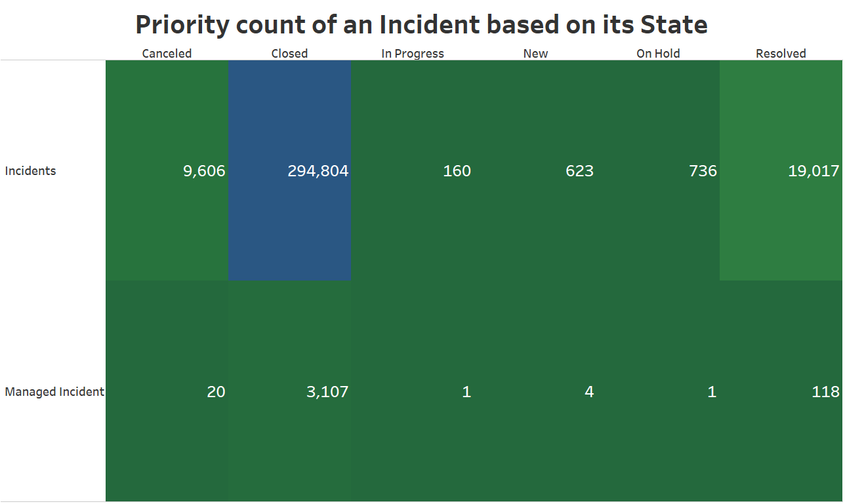
Exploratory Data Analysis
Missing data values
Priority | Impact | Assignment Group | Description | Total missing data points
43 | 44 | 4 | 4 | 5,141,406
Notes:
In this slide for the first graph we can see the number of priority incidents based on the impact of the incident. Average impacts had highest count of incidents
In the second graph we can see the incident based on its state. Highest count of incident based on its state is Closed incident.
There were few variables that we used in our modeling specifically and found if there were any missing values.
This table lists the missing values of those variables.
There were total 5.1 million missing data points in the entire data

Slide 8
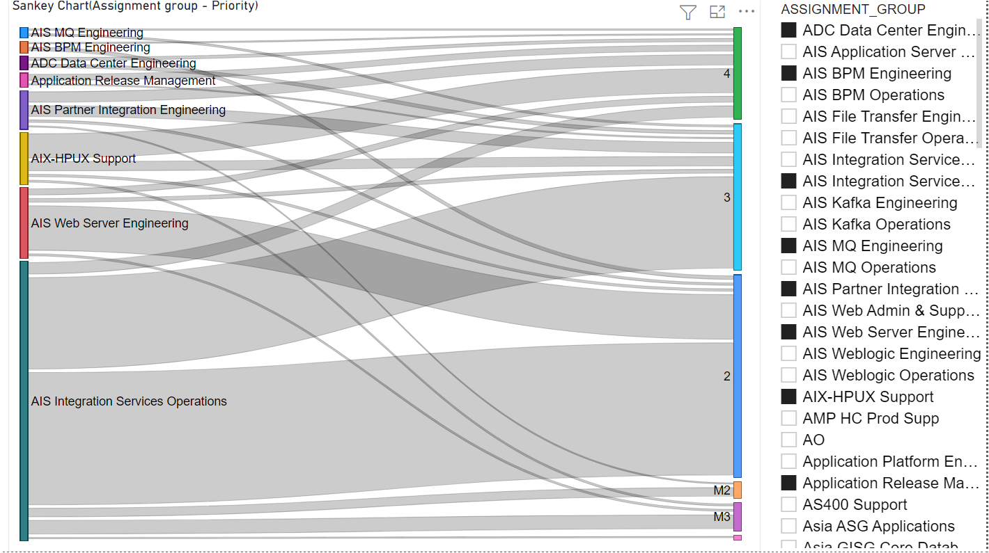
Sankey Diagram
Sankey chart represents as to which assignment group has got incidents of which all priorities
We can filter the data and use the slicer beside the chart to see the incident priorities for a particular assignment group as needed
Notes:
We further created Sankey diagram to help us to understand the flow in a system. Here, we used two fields from our dataset - assignment group and priority in order to see as to which assignment groups are being assigned incidents of what priority. Using the filter, we can select a single or multiple assignment groups at a time as per the requirement, to analyse the data.

Slide 9
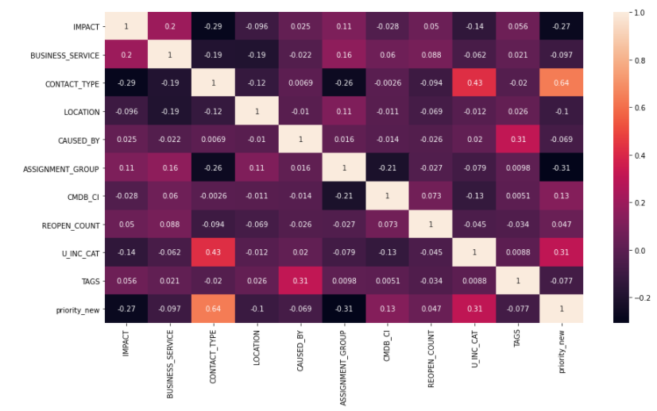
Correlation Analysis
From the heat map, we can say that the top 3 highly correlated fields with
Assignment_groups:
contact_type
cmdb_ci
business_service
priority_new:
contact_type
u_inc_cat
assignment_group

Slide 10
OBJECTIVE 1
Notes:
to predict the top 3 technology teams.

Slide 11
Preprocessing
Variable Description
Converted to Lower String
Removed funky characters : '+',' ', ^A-z
Removed english stop words: 'i', 'me', 'my', 'myself', 'we', 'our', 'ours', 'ourselves', 'you', "you're", "you've", "you'll", "you'd", 'your', 'yours', 'yourself', 'yourselves'
Tokenized words : 'device', 'host_systemedge', 'type'
Stemmed words : 'responding' - 'respond', 'management' - 'manag'
Notes:
*********************************************************************************************************
To predict the top 3 technology teams we first started with pre processing.
Talking about data preprocessing we first converted the entire description column into lower case, then we removed all the junk characters such as plus sign ,inverted commas and others then we removed all the stop words such as 'i',' me', 'myself' which basically do not add any predictive power to our model.
Post that we performed tokenization that is breaking the entire sentence into words and then performed stemming on those words which converted them into their root words for example words like connected, connecting, connection were reduce to a common word connect.
By doing data preprocessing we were able to clean and standardize our data and made it ready for modelling.

Slide 12
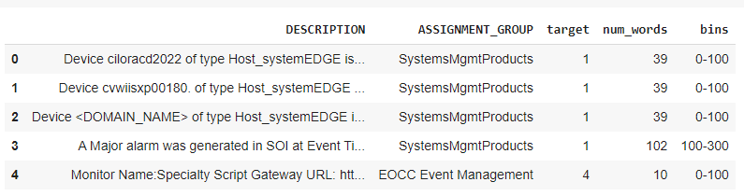
Methodology
Assignment Group:
Top 30 teams were identified based on the number of incidents received
Team 31 i.e. ‘Others’ was assigned to the rest of the teams
Variable Target created for team assignment based on the teams identified above
Variable Num_words created for word count in Description
Bins created based on the Word distribution in Description

Slide 13
Model Comparison
Models | Accuracy | Predictor variable: DESCRIPTION Target variable: ASSIGNMENT_GROUP
Deep Learning Model | 82%
Decision Trees | 90.25% | Predictor variable: DESCRIPTION, BUSINESS_SERVICE, CONTACT_TYPE Target variable: ASSIGNMENT_GROUP
Random Forest | 90.37%
Naive Bayes (Extra Trees Classifier) | 90.37%
KNN Classifier | 90.37%
Dense Neural Network | 91.00%
The models based on the correlated variables in the second table yielded improved accuracy and amongst them neural networks was the best with the highest accuracy.

Slide 14
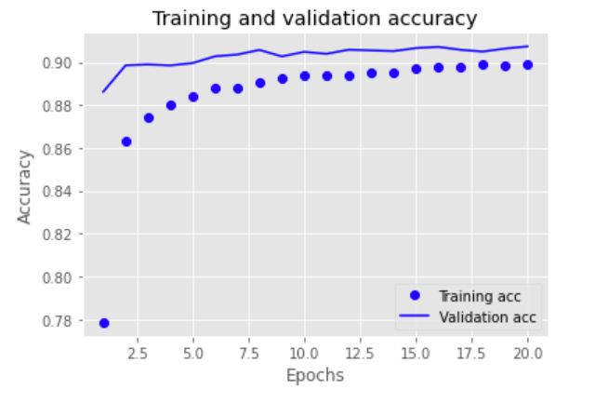

Results - Neural Networks
Neural Network Model gave the accuracy of 91%
Validation accuracy is higher as the Epochs increases
Interpretation of the results of the Neural Network model:
Top three teams for a particular incident with respective probability : 5,6,23

Slide 15
OBJECTIVE 2
Notes:
Moving on to the second objective, we approached it in two steps. For the first part, we built a model to identify if an incident is a managed incident or not and as an improvisation to it, for the second part, we further built a model to prioritize those incidents as M1, M2, M3 for managed incidents and 2,3,4 for non-managed incidents.

Slide 16



Methodology
Two methods of resampling
Binary class classification
Under Sampling :
Created a new data set with Target as 0 = M1, M2, M3 and 1 = Non-managed incidents
Sample size for Target variable : 0 = 3230, 1 = 3230
Preprocessing steps for Description was same as Objective 1
Over Sampling:
Sample size for Target variable : 0 = 325026, 1 = 325026
2. Multiclass classification :
Created groups for priority M1 = 0, M2 = 1, M3 = 2, 2 = 3, 3 = 4, 4 = 5, others = 30 as target variable
Sample size for Target Variable = 328193
Notes:
For objective 2 our methodology was divided into two parts, for the first part, we used binary classification in order to predict the probability of an incident becoming a managed incident. We created a dummy target variable which denoted 1 for managed incidents with priority M1, M2, M3 and 0 for other incidents with priority 2,3,4. Because the data was not balance, we used two methods of sampling to handle the modeling, oversampling and undersampling. As for the second part, in order to further classify and prioritize the incidents, we used multiclass classification method for which we implemented deep learning model. Preprocessing steps for Description was same as Objective 1

Slide 17
Model Comparison - Binary class classification
Sampling | Models | Accuracy (Predictor variable: DESCRIPTION) | Accuracy (Predictor variables: DESCRIPTION, CONTACT_TYPE, IMPACT, U_INC_CAT, ASSIGNMENT GROUP)
Undersampling | Decision Tree | 94% | 92.75%
 | Random Forest | 95% | 95.38%
 | Naive Bayes (Extra Trees Classifier) | - | 95.38%
 | KNN Classifier | - | 95.38%
 | Dense Neural Network | - | 93.00%
Over Sampling | Decision Tree | 99% | 99.35%
 | Random Forest | 99% | 99.46%
 | Naive Bayes (Extra Trees Classifier) | - | 99.46%
 | KNN Classifier | - | 99.46%
 | Dense Neural Network | - | 93.00%

Slide 18
Model Comparison - Multiclass Classification
Models | Accuracy | Predictor variable: DESCRIPTION Target variable: PRIORITY
Dense Neural Network | 91.00%
Decision Trees | 96.65% | Predictor variable: DESCRIPTION, CONTACT_TYPE, IMPACT, U_INC_CAT, ASSIGNMENT GROUP Target variable: PRIORITY
Random Forest | 97.02%
Naive Bayes (Extra Tree Classifier) | 97.02%
KNN Classifier | 97.02%
Dense Neural Network | 97.00%
The models based on the correlated variables in the second table yielded improved accuracy yet we choose the Dense neural network model using description as input variable.

Slide 19
Final Models - Overview
Objective 1 | Model | Accuracy
Models using correlated variables | Dense Neural network | 91.00%
Objective 2
Binary class Classification (Under / Oversampling) (slide 17) | Dense Neural Network | 93.00%
Multi-class Classification (slide 18) | Dense Neural Network | 91.00%
For Objective 1, we recommend Supervised learning dense neural network model with 91% accuracy
For Objective 2, we recommend Multi-class classification dense neural network model with 91% accuracy

Slide 20
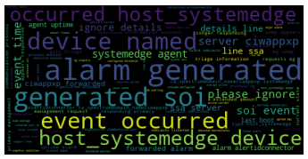



Recommendations
Limit the number of incidents and high priority incidents for a particular team at a particular time by re-routing to the next best team reducing the wait time of urgent incidents being managed.
Using certain machine learning and artificial intelligence algorithms, system should match the current issue with the past issues whose details are saved in the database. e.g. Tag a reference for quicker resolving of the issue.
Classify severity of incidents using on artificial intelligence and machine learning algorithms, focusing on urgent incidents, redirecting to top teams
e.g. Normal, Moderate, Urgent
Using chatbots for incidents with low priority. High priority and urgent incidents should be redirected to teams.
Notes:
Based on our analysis and modeling results, we have a few recommendations which addresses the concern of the company and may help to save time. Our first recommendation is to limit the number of incidents per technology team. It would not only enable each team to focus on the existing incidents but also distribute the workload amongst various team. Our model for the objective one can definitely serve this purpose by rerouting the incidents to the second best team predicted for it if the first team has reached its cap. Moving on to the second recommendation, we can have certain machine learning and artificial intelligence algorithms which can help match the incidents with the historical data. So, in case of any similarity, the past incidents and their method of resolution can serve as a reference for the resolution of the new incidents, which would further help save time. For the third recommendation, we suggest using algorithms that helps to determine the severity of the new incident as severity is one of the important factors in determining the priority. Apart from this, our forth and the last recommendation is to use chatbots which can address the low priority but high frequency incidents.
---------------------------------------------------------------------------------------------------------------------------------------------------------------------------------------------------------------------------------------------------------------------------------------------

Slide 21
Conclusion
The overall process of SEMMA* was applied to the historical data of Cigna Ticket system to predict the probability of an incident becoming a managed incident using NLP. This was conducted in order to:
Find the top 3 teams managing incidents based on the number of incidents received
Build and compare models to predict the probability of and incident getting managed based on the description, severity and impact of the incident for business recommendations
Allow the company to improve their ticket triage system for prioritization of urgent tickets, allocation to correct team for saving time and thus, improving business.
In conclusion, CIGNA can base its decision using the historical data and predicted models for future business decisions, optimization and customer satisfaction.
*SEMMA - Sample, Explore, Modify, Model, Assess
Notes:
Hereby, we conclude our presentation. We approached the two objectives individually. Using the historical data provided by the company and certain NLP and machine learning techniques, we developed two models to address the objectives and provide improvisations in the existing system and workflow of the company. Through the solutions provided by our team, the top 3 teams can be efficiently predicted to improve the routing accuracy of the incidents. Apart from this, by precisely predicting the probability of an incident becoming a managed incident we tried improving its real time prioritization.

Slide 22
Thank You
Notes:
Moving on to the second objective, we approached it in two steps. For the first part, we built a model to identify if an incident is a managed incident or not and as an improvisation to it, for the second part, we further built a model to prioritize those incidents as M1, M2, M3 for managed incidents and 2,3,4 for non-managed incidents.

Slide 23
Appendix

Slide 24
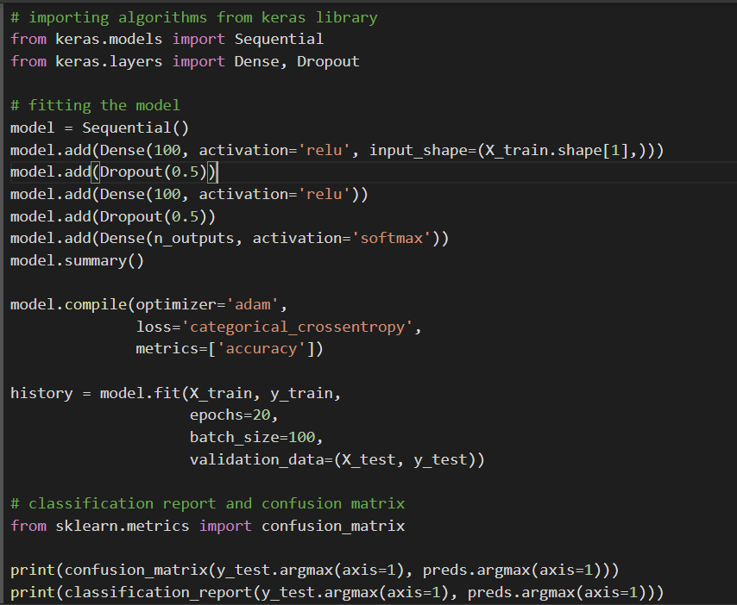
Appendix - Objective 1
Model fit code of Approach 1 (Supervised learning Algorithm)

Slide 25
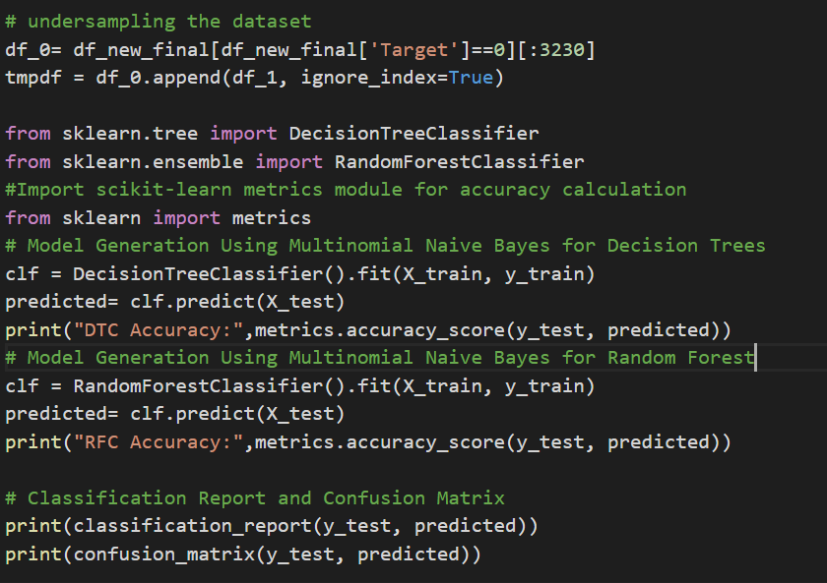
Appendix - Objective 2
Model fit code of Binary Classification - Undersampling

Slide 26
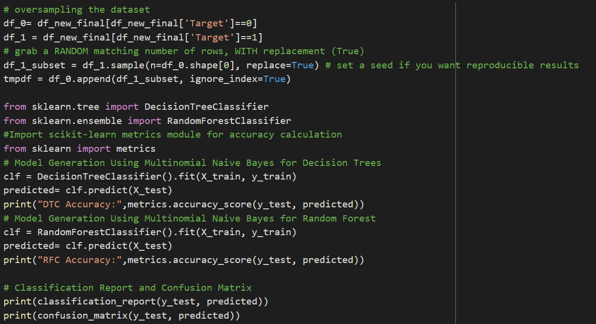
Appendix - Objective 2
Model fit code of Binary Classification - Oversampling

Slide 27
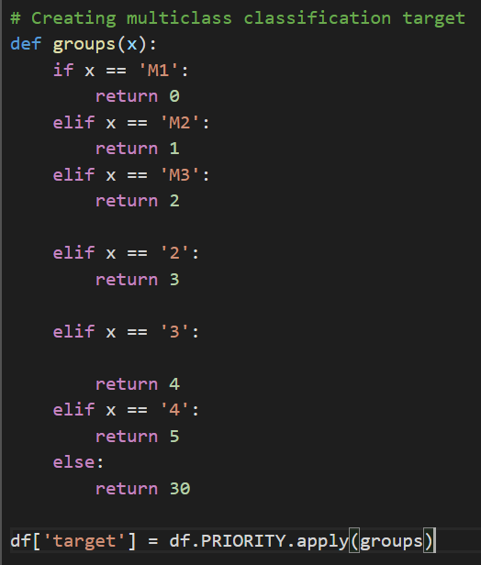
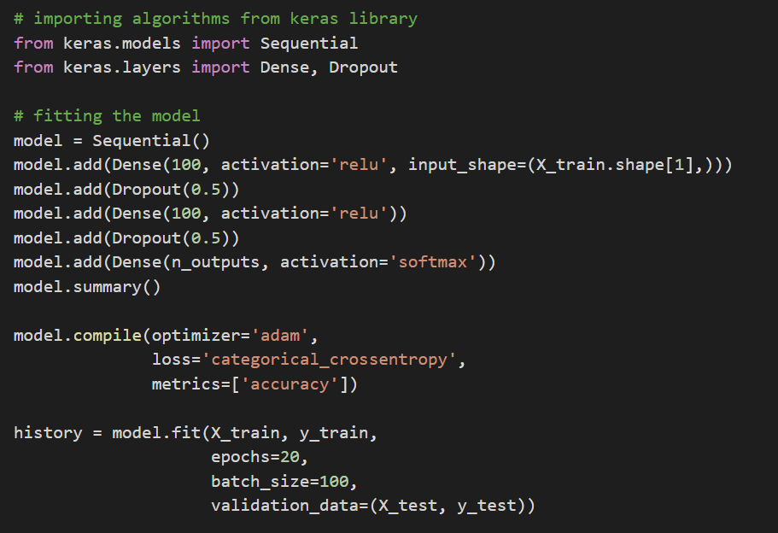
Appendix - Objective 2
Model fit code of Multiclass Classification

Slide 28
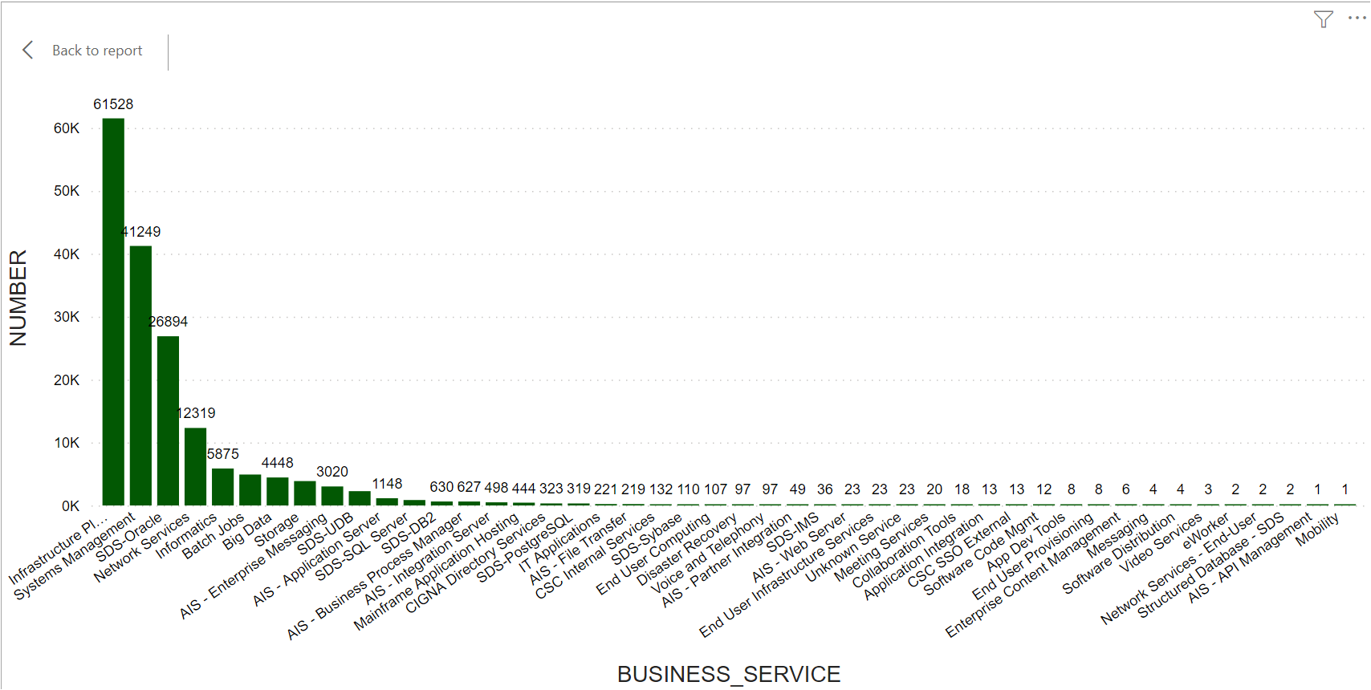
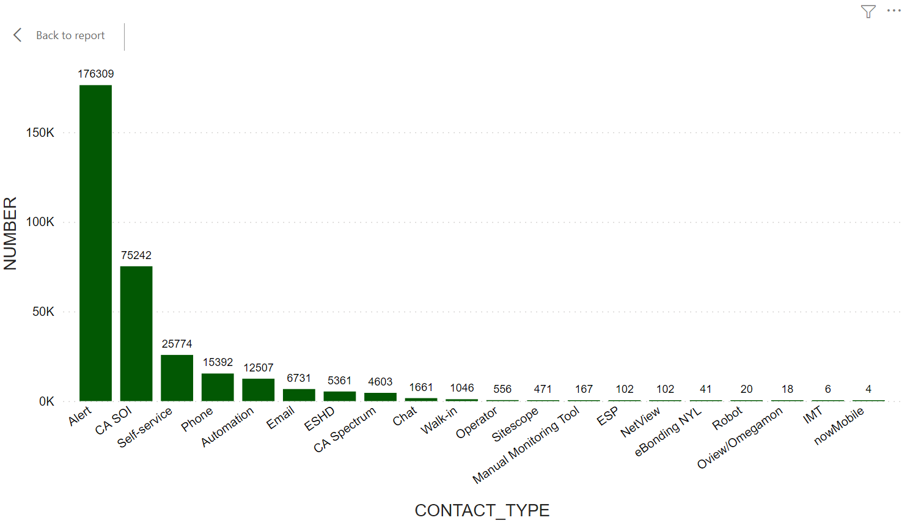
Exploratory Data Analysis
Number of Incidents in each BUSINESS_SERVICE category
Number of Incidents in each CONTACT_TYPE category
Word Cloud was created using NLP for improved model accuracy

